Slide 1



My Probability Interactive Notebook
Name
Class
Teacher Mr Evans
Term 2 Semester 1
1

Slide 2
Create your own front page
It needs to contain the following –
My number interactive notebook
Name
Class
Teachers Name
Semester 1 Term 1
Page number 1

Slide 3
Contents
Glossary or Formula Page
Page
Date
Description
2
3

Slide 4
Tasks
24
7
30
Essential Question
Questions
Notes
Summary
4
5

Slide 5
24
7
30
Date
Simplified Tree Diagrams
EQ – What is a Simplified Tree Diagram?
A simplified tree diagram shows repeated branches on a normal tree diagram as single branches. You write a fraction in the combined branch. The numerator shows the number of repeated branches that have been combined. The denominator shows the original number of branches before combination.
How is a Simplified Tree Diagram different to a normal tree diagram?
5

Slide 6
24
7
30
Date
Simplified Tree Diagrams
EQ – What is a Simplified Tree Diagram?
A simplified tree diagram shows repeated branches on a normal tree diagram as single branches. You write a fraction in the combined branch. The numerator shows the number of repeated branches that have been combined. The denominator shows the original number of branches before combination.
How is a Simplified Tree Diagram different to a normal tree diagram?
Example
5

Slide 7
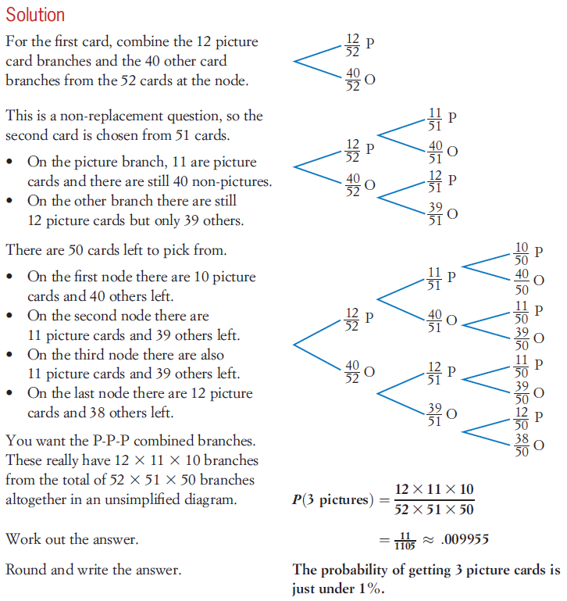
24
7
30
Date
Simplified Tree Diagrams
EQ – What is a Simplified Tree Diagram?
How is a Simplified Tree Diagram different to a normal tree diagram?
5

Slide 8
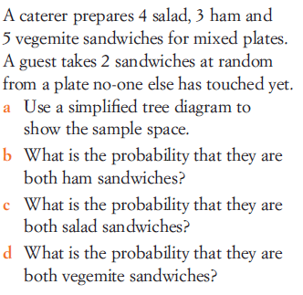
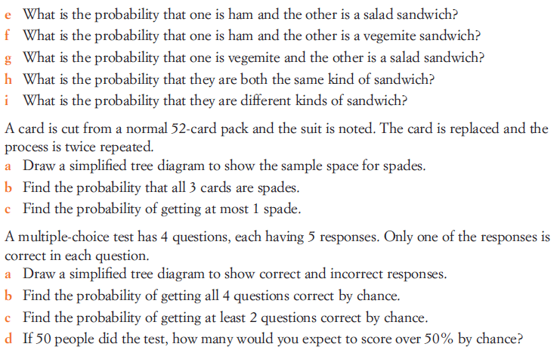
Task

Slide 9
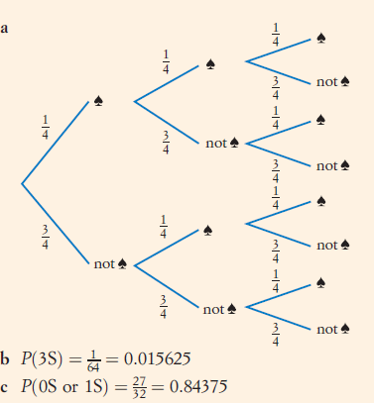
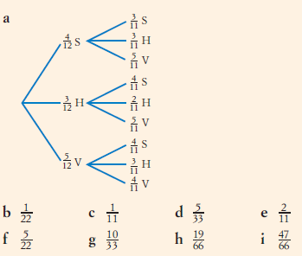
Answers

Slide 10
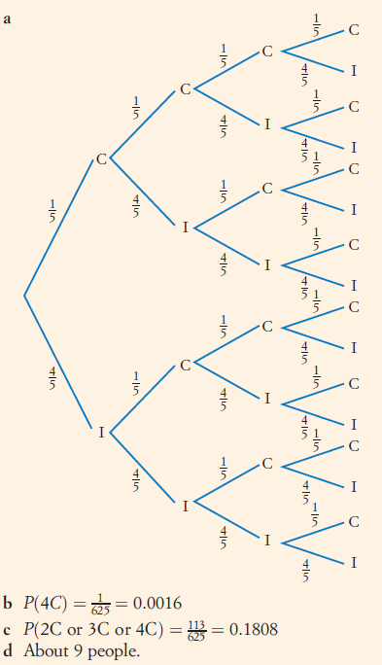
Answers

Slide 11
Notes Review
24, 7 ,30
Date
Title
Essential question
Notes complete
Notes complete with colour and diagrams
Questions completed
Contents page filed in
Formula page filled in

Slide 12
Homework
Review your notes and write a summary answering the essential question.

